Slide 1
MongoDB for .NET Developers
David Green

Slide 2

About Me
I currently live in Raleigh, North Carolina with my wife and three kids.
Developer for 15+ years in the MSFT stack (C#, ASP.NET MVC, SQL Server, and etc.)
I like NoSQL and Machine Learning these days.
Organizer for Raleigh Code Camp and speaker chair Monthly Triangle .NET Meetup Group. And I like movies.

Slide 3

Agenda
Introduction
Concepts & Fundamentals
Exploring MongoDB (console, Robomongo)
Developing with MongoDB in C#
Advanced Features
Final Remarks
“…and transparent fault tolerance” - Tom Cruise (Maverick)

Slide 4
It’s a database.
What is MongoDB?
CouchDB
RavenDB
Hbase
Cassandra
Hypertable
But let me explain…

Slide 5
THE BIG PICTURE
NOSQL
Redis
Riak
Memcached
CouchDB
RavenDB
RDMS
NewSQL
Hbase
Cassandra
Hypertable
Neo4J
GiraffeDB
InfiniteGraph
All Databases
Notes:
100,000 ft view => Lot of databases out there (i.e. just for NoSQL we have http://nosql-database.org/)

Slide 6
What is NoSQL?
Martin Fowler: Some characteristics are common amongst these databases, but none are definitional.
Redis
Riak
Memcached
CouchDB
RavenDB
Model not using the SQL language
Designed to run on large clusters
Not using the relational model
Hbase
Cassandra
Hypertable
Neo4J
GiraffeDB
InfiniteGraph
No schema enforced
Open source

Slide 7
NoSQL DATABASE FAMILIES
Key-Value
Document
Redis
Riak
Memcached
CouchDB
RavenDB
Columnar
Graph
Hbase
Cassandra
Hypertable
Neo4J
GiraffeDB
InfiniteGraph

Slide 8
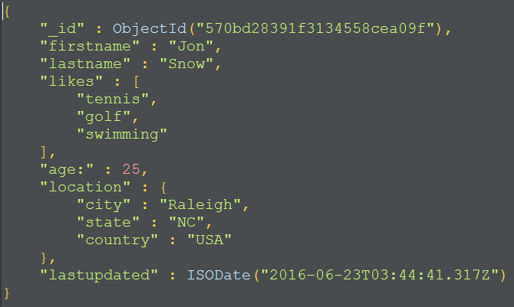
What is MONGODB?
Open source NOSQL database
Document orientated (storing JSON-like documents)
Includes a strong query language (JavaScript)
Scales well horizontally – sharding & replication
Highly available while maintain strong consistency
Cross-Platform (driver support for C#, Java, Python, etc.)

Slide 9
MongoDB 3.2 – a BIG Release
Document Validation
Fast Failover
Simpler Scalability
Aggregation ++
Encryption At Rest
In-Memory Storage Engine
BI Connector
$lookup
MongoDB Compass
APM Integration
Profiler Visualization
Auto Index Builds Backups to File System
Doc-Level Concurrency
Compression
Storage Engine API
≤50 replicas
Auditing ++
Ops Manager
$out
Index Intersection
Text Search
Field-Level Redaction
LDAP & x509
Auditing
Hash-Based Sharding
Roles
Kerberos
On-Prem Monitoring
Agg. Framework
Location-Aware Sharding
2.2
2.4
2.6
3.0
3.2
Notes:
Emphasis on MongoDB adopting a rapidly iterative approach to rolling out features 3.2 Document Validation = Data Governance 3.2 Encryption at Rest is huge (but part of Enterprise Version) 3.2 $lookup is huge (joins) 3.2 Compass is a great tools for DevOps (enterprise only). 3.0 Compression in is huge (70% reduction on average!) 3.0 Storage Engine is huge (and allows for In-Memory Storage Engine)

Slide 10
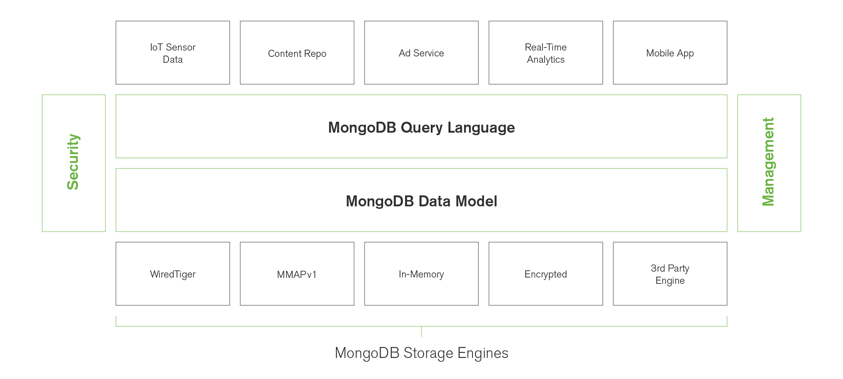
Flexible Storage Architecture in 3.2
Notes:
How much faster is Memory vs. SSD
10x - 25x
RAM (Memory) is not as durable and more expensive per GB (also about 10x $$$ per GB).

Slide 11
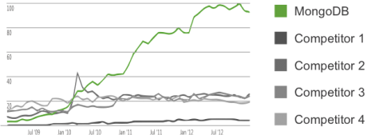
Search Trends – Google
Notes:
Why this slide? For any number of reasons I could have picked any other NoSQL Database. But Google trends gives you and idea of relevancy. And this database, by an order of magnitude, is the most relevant. Even if your not a MEAN stack developer, MongoDB is the dominant database platform in the NoSQL space.

Slide 12

Agenda
Introduction
Concepts & Fundamentals
Exploring MongoDB (console, Robomongo)
Developing with MongoDB in C#
Advanced Features
Final Remarks
“Yeeeah…did you get that memo about MongoDB’s cross-driver platform support?” – Bill Lumburgh

Slide 13
When you say…IN MONGO IT’s LIKE…
SQL Term | Mongo Term
database | database
table | collection
index | index
row | document
column | field
table joins | embedding & linking
primary key | _id
aggregation (e.g. group by) | map/reduce –or– aggregation pipeline

Slide 14
BSON DATA FORMAT
JSON
BSON = JSON +
Number
String
Boolean
Array
Object
null
ObjectId
DateTime
Byte Arrays
GeoSpatial

Slide 15
Example BSON Document

Slide 16

Agenda
Introduction
Concepts & Fundamentals
Exploring MongoDB (console, Robomongo)
Developing with MongoDB in C#
Advanced Features
Final Remarks
“I love how MongoDB can be highly available while maintaining that strong consistency.” - Tiger Woods

Slide 17
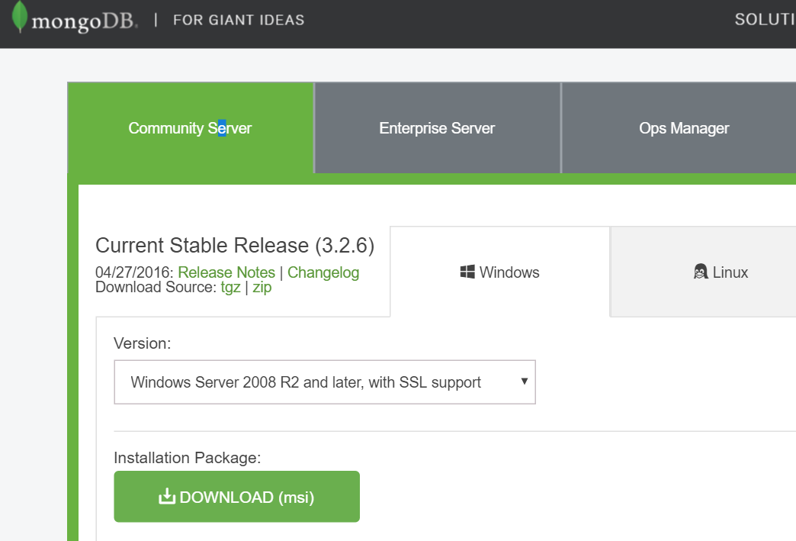
Installing MongoDB
https://www.mongodb.com/download-center#community

Slide 18
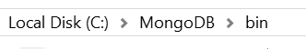
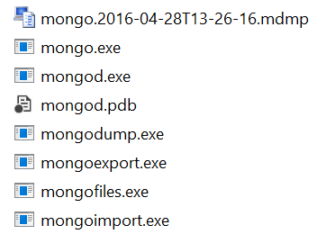
Installing MongoDB (cont’d)
Executables install path
MongoDB interactive console (CLI)
MongoDB server
Running MongoDB server

Slide 19
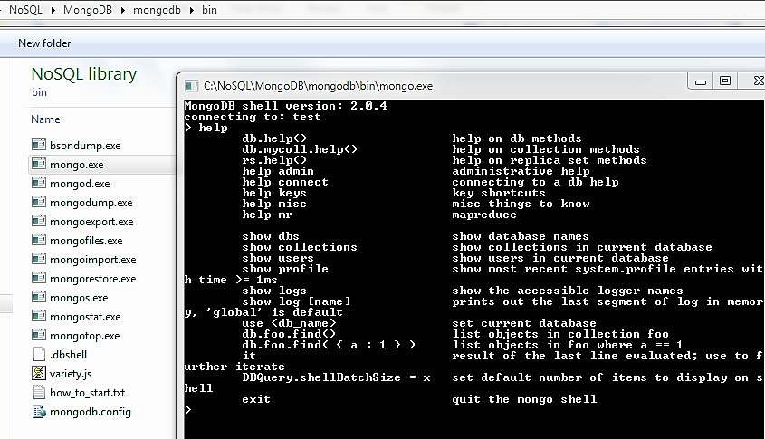
Using the console
Notes:
1) Use, show dbs, show collections 2) Javascript
3) Simpledb insert 4) Advanced Javascript 5) db.products.find( { quantity: { $gt: 50 }, category: "apparel" } ).explain("executionStats")

Slide 20

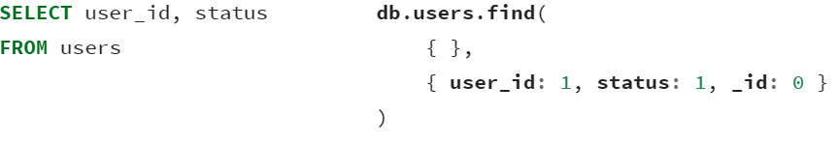
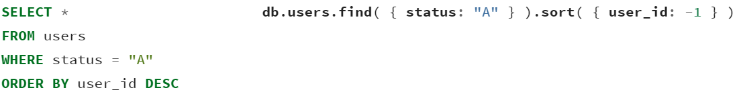
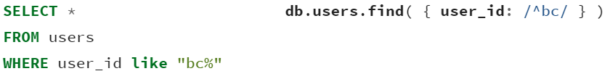
Simple Query Translations
SQL SELECT Statements
MongoDB find() Statements
https://docs.mongodb.com/manual/reference/sql-comparison/

Slide 21
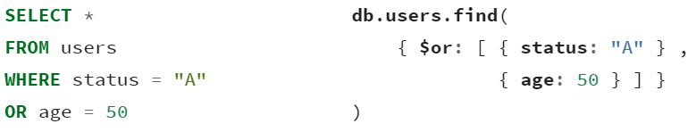
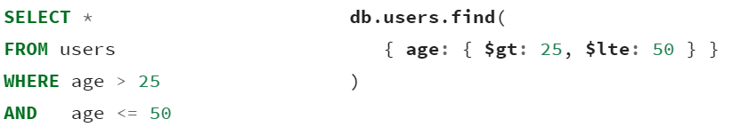
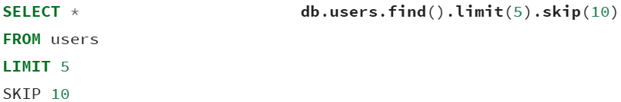
Simple Query Translations (CONT’D)
SQL SELECT Statements
MongoDB find() Statements
https://docs.mongodb.com/manual/reference/sql-comparison/

Slide 22

Agenda
Introduction
Concepts & Fundamentals
Exploring MongoDB (console, Robomongo)
Developing with MongoDB in C#
Advanced Features
Final Remarks
Distributed computing

Slide 23
C# DEMO
Basic CRUD examples and aggregation framework example:
https://github.com/davidjeet/MongoDB-Presentation.git
Notes:
There *is* a way to query MongoDB over REST for admin purposes (reads only), but it’s generally considered a security risk and it’s a feature disabled by default. Some languages (Python, Java, Node) offer REST SDKs (they are deployed on the MongoDB server).

Slide 24

Agenda
Introduction
Concepts & Fundamentals
Exploring MongoDB (console, Robomongo)
Developing with MongoDB in C#
Advanced Features
Final Remarks
“I loved it when a sharded replica set comes together” - Antonio Banderas

Slide 25
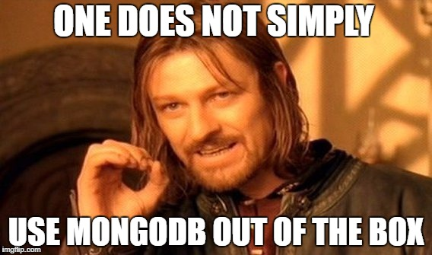
Advanced FEatures
REPLICATION/ SHARDING
JOINS ($lookup)
AGGREGATION
GRIDFS

Slide 26
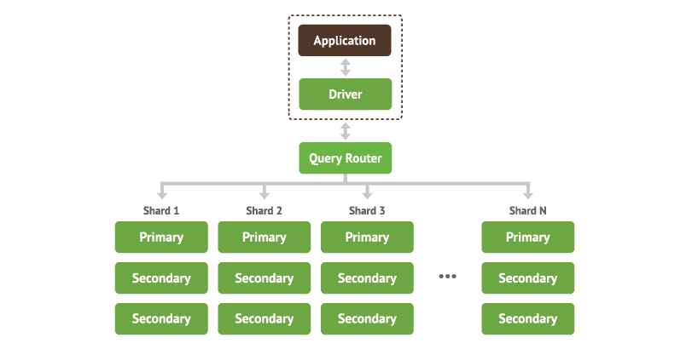
Sharding & Replication
Sharding allows for horizontal scaling (partition tolerance).
Replication allows for high availability.
In combination, the number of servers to manage can grow quite quickly!
Notes:
Support for this has been around for the earliest versions of MongoDB. It is in fact what makes MongoDB so powerful.

Slide 27
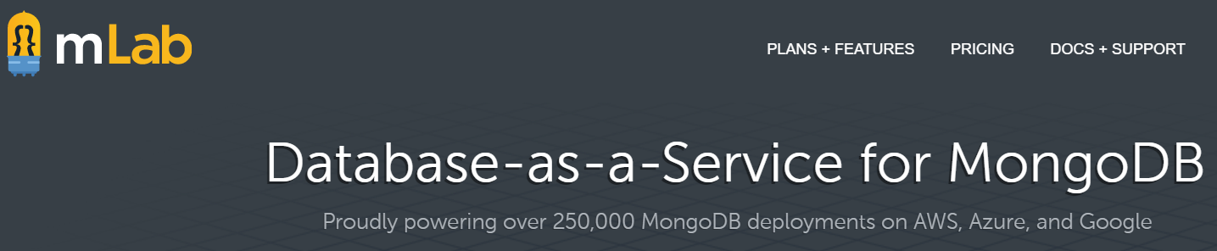
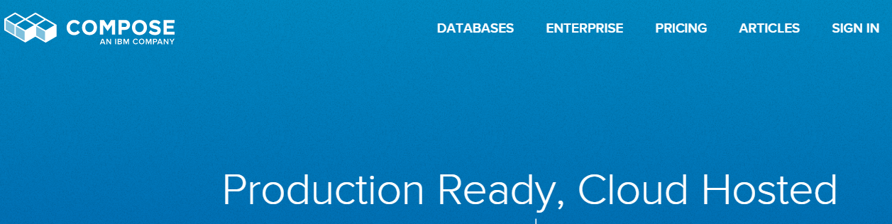
MONGDB AS-a-SERVICE
Notes:
MongoDB is looking into this space as well => to provide a PAAS like offering, similar to DocumentDB

Slide 28
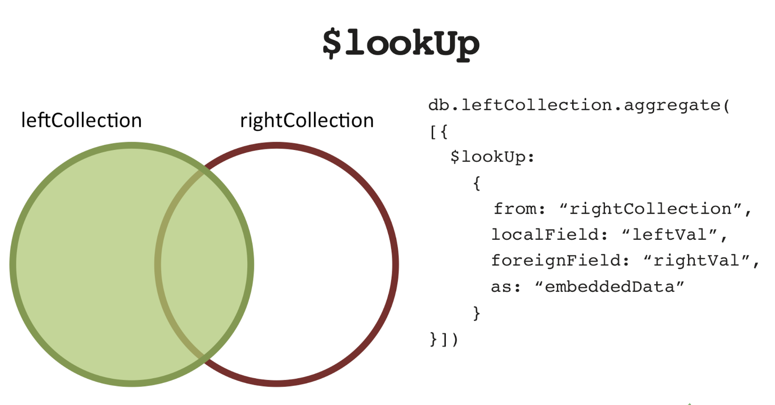
Joins (Mongo v3.2+)
Notes:
Still very new feature, still learning more about it. But it is to be used to handle exceptional cases rather than the norm - not an excuse to retain relational database schema modeling!

Slide 29
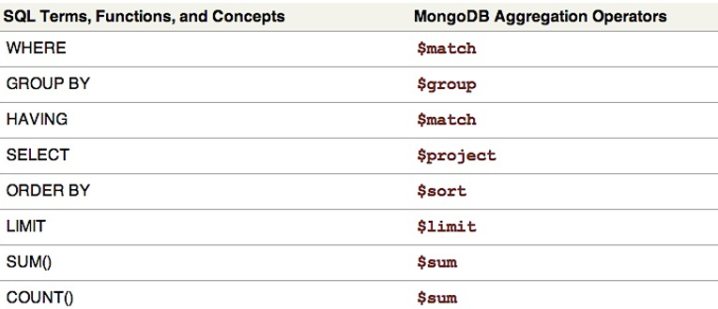
Aggregation Framework

Slide 30
EXAMPLE Aggregation Query EXAMPLES
1) Sums up population of each state.
db.zips.aggregate([
{$group: { _id: "$state", population: { $sum: "$pop"} }},
{$sort: {population: 1}}
])
3) Tag Cloud query
db.posts.aggregate(
[
{ $unwind : "$Tags" },
{ $group : { _id : "$Tags" , number : { $sum : 1 } } },
{ $sort : { number : -1 } }
]
)
2) Counts posts by user name (most to least) w/ minimum of 5 posts attributed to that user
db.posts.aggregate([
{$group: { _id: "$OwnerDisplayName", count: { $sum: 1} }},
{$match: { count : { $gte: 5 }} },
{$sort: {count: -1}}
])
Notes:
Notice, the "array" as the aggregate function argument. Each { } is a statement in a pipeline. More zip code examples in:
https://docs.mongodb.com/v3.0/tutorial/aggregation-zip-code-data-set/

Slide 31
GridFS
GridFS is MongoDB’s way of storing files in the database.
The files are stored in binary chunks that around 256k in size.
File
GridFS
Chunk
Chunk
Chunk
Chunk
Notes:
GridFS example: http://www.tutorialspoint.com/mongodb/mongodb_gridfs.htm

Slide 32

Agenda
Introduction
Concepts & Fundamentals
Exploring MongoDB (console, Robomongo)
Developing with MongoDB in C#
Advanced Features
Final Remarks
“This NoSQL stuff kinda makes sense now…” - David Duchovny (X-Files)

Slide 33
WHEN TO USE MongoDB (Technical CASE)
Data Structure
Document-like
Semi-structured
Few Joins
Geospatial
Data Volume
Large or Huge
Distributed
Unpredictable

Slide 34
MongoDB USE CASES (BUSINESS CASE)
Document Management systems
E-commerce (catalog portion only)
Archiving / event logging
Real time analytics (based on logging)
Gaming
Geospatial
Mobile

Slide 35
Resources
MongoDB
MongoDB.com
Books MongoDB: The Definitive Guide 2nd Edition (Kristina Chodorow)
Video Tutorials (developers) Pluralsight: Using MongoDB with ASP.NET MVC (Wes Higbee)
Pluralsight: Using the MongoDB C# v2 Driver (Wes Higbee)

Slide 36

Questions?
Twitter: @davidjeet
Blog: endgameanalytics.com
LinkedIn: www.linkedin.com/in/nosqlguy
GitHub: github.com/davidjeet
Thank you for coming.

